Slide 1

Agile Software Engineering
Understanding Different Types of Agile

Slide 2
How do you know when a software development organization has become Agile?
Is there such a thing as a completely Agile organization?
An Agile organization is quite simply one that is adaptive to change.
This could be the software development arm of a company or any other area, such as marketing or finance.
These areas have put policies and tools in place that enable them to be highly reactive to issues and opportunities as they arise.

Slide 3
An Agile software development organization is one that uses Agile tools, techniques, and cultural norms to develop their products.
Becoming an Agile organization is more of a journey than a destination.
Most organizations use a combination of Agile tools and methodologies that best support their goals and objectives.

Slide 4
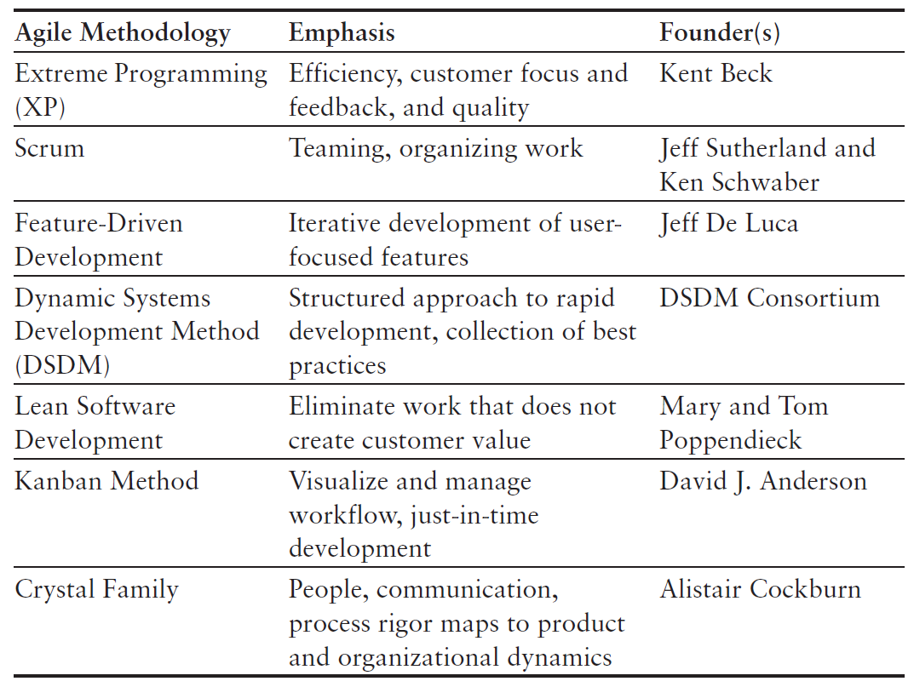
Comparing Agile Methodologies

Slide 5
Extreme Programming (XP)
The idea of Extreme Programming started at Chrysler Motors in 1996 with a payroll project named the Chrysler Comprehensive Compensation System (C3).
The project team, led by Kent Beck, was struggling with how to release high quality code much faster and more efficiently, and as a result morphed their development process to be efficient, with a quality focus.
In 1999, the popularity of Extreme Programming took off when the ideas developed during the C3 project were documented in a book written by Beck called Extreme Programming Explained.

Slide 6
Extreme Programming (XP)
Techniques and principles from Extreme Programming are now some of the most popular in Agile software development and focus on the following key themes:
Frequent releases, short development cycles
Pair programming
Regular builds and integration tests
Quality and avoiding code breakage
Simplicity of code, coding only what is needed
Rapid and regular feedback

Slide 7
Extreme Programming (XP)
Frequent Releases, Short Development Cycles
XP introduced the idea of smaller and more frequent development cycles.
Traditionally, software had been developed using a lengthy design proposal and modification phase followed by the coding of all of the requirements for the new version of the product.
In contrast, XP practitioners argued that code is more useful than extensive documentation and that developers should put their focus on developing quality code rather than on documenting what they plan to code.

Slide 8
Extreme Programming (XP)
Frequent Releases, Short Development Cycles
The process also relies heavily on an automated unit-testing strategy known as test-driven development (TDD).
When practicing TDD, developers write automated unit tests before writing the corresponding production code; code is not considered complete until all automated tests pass.

Slide 9
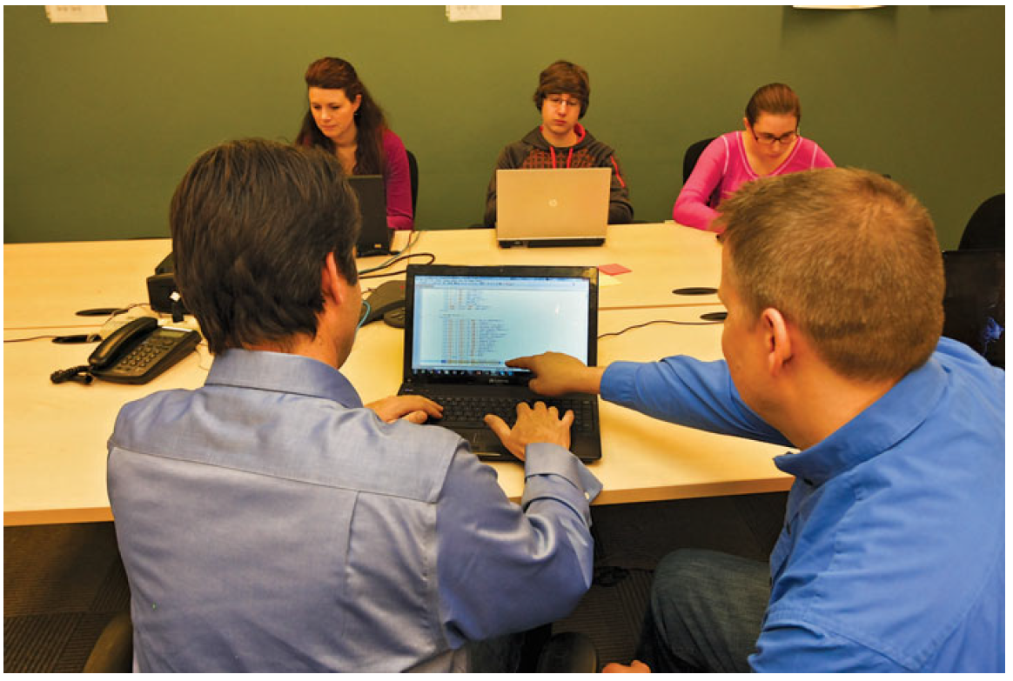
Extreme Programming (XP)
Pair Programming
Pair programming is an exercise where two developers work together to create production-ready code.

Slide 10
Extreme Programming (XP)
Pair Programming
Ideally, paired developers would write all production code.
When pairing is not possible, a developer should write nonproduction code.
Pair programming has become a popular XP tool because code is regularly reviewed by more than one person, resulting in higher-quality code.
It also exposes team members to a broader range of the product’s code,
which aids in cross-training and learning development best practices from one another.
Some teams pair developers and testers so the code gets an early review and to also help testers learn more about new fixes or features.

Slide 11
Extreme Programming (XP)
Pair Programming
There are some basic guidelines that programmers should follow when they are pairing.
The first is that the development space should accommodate two developers working side by side.
The developers share a keyboard and either use dual screens or share a large screen.
Both developers should be active participants in the creation of the code, and the pairing should end when one or both developers feel tired and unable to concentrate.

Slide 12
Extreme Programming (XP)
Regular Builds, Integration Tests, and Rapid Feedback
Regular builds and integration tests were introduced in XP to alleviate the problem of high defect counts during builds and code integration.
Previously, it was not uncommon to have a weekly build or code integration at the end of the development cycle.
XP encourages a minimum of a daily build with code integration happening every time a developer checks in new code.

Slide 13
Extreme Programming (XP)
Regular Builds, Integration Tests, and Rapid Feedback
Some organizations that have adopted this XP technique use a flashing light or a siren if new code that is checked in to the code build introduces an error; this rapid feedback enables the developer to respond quickly to the error so that quality builds can be maintained.
This also makes fixing errors easier because developers are working with code they recently developed.

Slide 14
Scrum
According to the Webster dictionary definition, a “scrum” is a rugby play in which the forwards of each side come together in a tight formation and struggle to gain possession of the ball using their feet when it is tossed in among them.
Rugby is a game that cannot be won by a single superstar; it takes a full team, working closely together, to be successful.
The same is true with Scrum software development.
Each member of the Scrum team is vitally important and must contribute if the team is to be successful.

Slide 15
Scrum
According to the Webster dictionary definition, a “scrum” is a rugby play in which the forwards of each side come together in a tight formation and struggle to gain possession of the ball using their feet when it is tossed in among them.
Rugby is a game that cannot be won by a single superstar; it takes a full team, working closely together, to be successful.
The same is true with Scrum software development.
Each member of the Scrum team is vitally important and must contribute if the team is to be successful.

Slide 16
Scrum
Despite Scrum’s overwhelming popularity with companies that decide to adopt Agile methodologies, many are still uncertain about what it entails.
Many consider XP to have a technical or developer focus, but Scrum tends to address more of the project management and teaming aspects of software development.

Slide 17
Scrum
Scrum emphasizes the importance of organizing a project into specific durations, known as time boxes, that help the team know what they need to focus on each day and encourage a sense of urgency.
Work requirements are grouped into chunks of work that can be completed in one- to six-week time frames called sprints.
All design, development, test, and customer validation work is contained within the sprint; the goal is that by the end of the sprint, the new functionality is ready to deliver to customers.

Slide 18
Scrum
The product owner selects work requirements for each sprint. The product owner maintains a prioritized list of requirements for the product called a product backlog.
The requirements are written in the form of user stories or stories about the problem that needs to be solved by the requirement.
User stories are covered in more detail in Chapter 5, “The New Way to Collect and Document Requirements.”
Tracking is also an important part of the Scrum approach.
Scrum teams meet daily in what is commonly referred to as a daily stand-up or daily Scrum meeting.

Slide 19
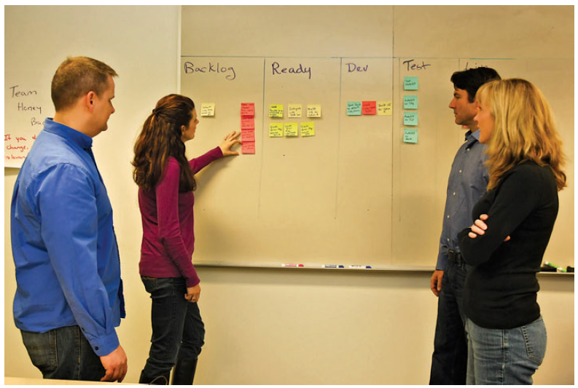
Scrum

Slide 20
Scrum
A Scrum master is assigned to lead these meetings to ensure that they remain brief and focused and that all team members have a chance to contribute.
These meetings are designed to be short (usually around 15 minutes), and each team member answers the following questions:
What have I done since yesterday?
What am I doing today?
Any roadblocks?
The team also uses burn down or burn up charts to track progress through the sprint.

Slide 21
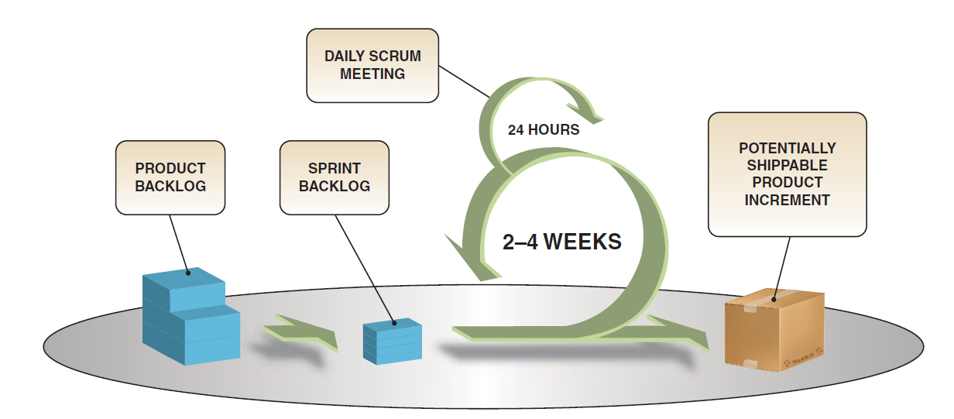
Scrum
Scrum process is the most widely adopted Agile methodology.

Slide 22
Feature-Driven Development
This methodology is called Feature-Driven Development because the planning and development focus on the specific features that address customer requirements.
The value of FDD is “to enable the reliable delivery of working software in a timely manner with highly accurate and meaningful information to all key roles inside and outside a project.”

Slide 23
Feature-Driven Development
FDD has been adopted by the Agile Alliance as a recognized Agile methodology.
Product features are developed in two-week iterations and focus on the following activities:
1. Create the model—Perform an initial customer walk- through that determines scope and context and creates the model.
2. Develop the feature list—The model determines the features. Features are often described as a sentence in a format that looks something like this:
  <verb> the <something> for/of/to a(n) <something else>.
  <verb> the “<result>” by|for|of|to a(n) <object>

Slide 24
Feature-Driven Development
  <verb> the <something> for/of/to a(n) <something else>.
  <verb> the “<result>” by|for|of|to a(n) <object>
For example, for a movie review site, the features might say:
a. Calculate the average star rating for a movie
b. Calculate the “go” or “don’t go” recommendations for a movie
c. List the local movie theaters to show the current movie locations <calculate> the <average star rating> for a <movie>

Slide 25
Feature-Driven Development
Features are then ordered and assigned to classes.
1. The plan is determined by features
  Unlike other Agile methodologies, FDD advocates that teams create a development plan that is based on ordering features and assigning them to classes. Classes are then assigned to an owning developer.
2. The design is based on the features
  The owning developer assigns a small set of features that can be developed in two weeks. Detailed sequence diagrams are created based on features, and the overall model is updated to reflect the changes. Classes are written, and a design review is held.
3. The build is based on the features
  Code is developed based on feedback from the design review. Once the developer completes the code and unit testing, then a code review is held to analyze whether final changes are needed. Final updates to the code are made and the code promoted to the current build.

Slide 26
Dynamic Systems Development Method
Dynamic Systems Development Method (DSDM) was introduced in 1994 as a framework to provide more structure to rapid application development (RAD).
RAD is a product development approach that focuses on creating working prototypes as efficiently as possible by minimizing process rigor and overhead.
Their most recent version of the framework, Atern, touts that it helps organizations “deliver the right product at the right time.”
Project teams must decide which requirements are “musts, shoulds, coulds and won’t haves” to meet that objective.

Slide 27
Dynamic Systems Development Method
DSDM is part of the Agile Alliance and focuses on the project management aspects of Agile software development and non-IT projects; it is often considered a complementary approach to Extreme Programming.
DSDM relies on nine core principles, all of which must be followed to ensure the best chances of a successful project:

Slide 28
Dynamic Systems Development Method
1. Active user involvement is critical for any project.
2. Teams must be empowered to make decisions.
3. Teams need to focus on frequent product delivery.
4. Criteria must be in place for an approved deliverable.
5. All development must be done iteratively and delivered incrementally.
6. Any change introduced during development must be reversible.
7. Product requirements are baselined as high-level themes rather than low-level changes or improvements.
8. Product testing is performed throughout the project life cycle.
9. Team interactions are collaborative and cooperative.

Slide 29
Dynamic Systems Development Method
In addition to the nine principles, four major phases are used to iterate through during the project, including
1a. Feasibility Study
  The project team identifies the functionality that will be included, creates and tests a functional prototype, and develops a timeline for the project.
1b. Business Study
  The business processes and associated requirements are analyzed by the project stakeholders using the MoSCoW requirement prioritization method.
  MoSCoW prioritizes requirements based on what the product “must have,” “should have,” “could have,” and “won’t have.”

Slide 30
Dynamic Systems Development Method
2. Functional Model Iteration
  Requirements from the business study are translated into functional models that are tested and reviewed by user groups. The project team iterates on the functional models with users until there is agreement that the models are ready to proceed to a design prototype.
3. Design and Build Iteration
  All of the functional models are brought together to create a design prototype; this prototype incorporates all product functions and again is tested and reviewed by user groups. The result is a working prototype that includes user documentation.
4. Implementation
  The final phase includes user acceptance of the product and implementation in their environment. Users are trained, and the project team reviews the business objectives to ensure the user goals have been achieved.

Slide 31
Lean Software Development
Lean software development stems from the world of manufacturing, which has widely adopted the idea of Lean manufacturing.
Lean manufacturing is built on the idea that all processes and resources must directly contribute to creating something of value to the customer; customer value is defined as anything that a customer is willing to purchase.
Anything outside this scope is considered wasteful, and every effort must be made to eliminate the waste.
Lean software development subscribes to the same principles but relates them to the development of software.

Slide 32
Lean Software Development
Following are the seven principles of Lean software development:
Eliminate waste
  Remove anything that does not add customer value
Amplify learning
  Regularly test code, learn by doing rather than documenting or planning, gain customer feedback through prototypes
Decide as late as possible
  Wait to get facts rather than making Assumptions
Deliver as fast as possible
  Focus on speed to market
Empower the team
  Managers allow team members to make key decisions
Build integrity in
  Pieces work together as a whole
See the whole
  Focus on the entire product experience rather than the pieces

Slide 33
Kanban Method
The Kanban method was developed by David J. Anderson, who was interested in “just in time” software delivery and evolving the process to create an optimal system.
The word Kanban loosely translates to “signboard” in Japanese.
A signboard is traditionally described as a visual process-management system that tells teams what to produce, when to produce it, and how much to produce.
The visual signboard and work-in-progress pull method, also known as the Kanban system, is the most popular tool that organizations adopt when they use the Kanban method.

Slide 34
Kanban Method
The Kanban method is based on four key principles:
Foster leadership at all levels of the organization
  Everyone in the organization is encouraged to act as leaders, from the entry-level employee to the executive team.
Start with what you know
  Kanban is not prescriptive in nature and assumes that organizations are not all the same. Instead, it is important to understand where you are today and use change management approaches to evolve from that point.
Focus on incremental and evolutionary change
  The goal is not to overhaul the process, culture, and product overnight. Instead, it is important to make small but impactful changes often.
Respect current methodologies and roles
  The current process was put there for a reason; something about it has worked, and that is why people have continued to use it.
  It is important to preserve what has worked and to change what is no longer helping the team achieve their goals.

Slide 35
Kanban Method
Six core practices are central to the Kanban method:
Visualize workflow
  Teams need to visually understand their work so that they can optimize their workflow. The Kanban method often uses a board with columns and cards to show the workflow.
Limit work in progress, and pull in new work only when time becomes available
  The team cannot be efficient and focused if too much work is on their plate; it is important to focus on one task at a time and not to start a new task until the current task is completed.
Manage the flow through the system
  Just as with a relay race, the team needs to understand how the work progresses toward the goal. The team needs to ensure that the appropriate level of work is flowing through the system and that bottlenecks are being kept to a minimum.

Slide 36
Kanban Method
Provide explicit policies
  The team needs to understand how to work within their organization in order to eliminate ambiguity. For example, a team may enact the policy that they do not pull a new feature until the current feature has been through unit test.
Improve collaboratively and evolve experimentally
  A team can best improve if members first have a shared vision and work together to generate ideas for improvement.
  Evolution cannot happen through guesswork or intuition; the team needs to try new approaches and objectively evaluate their merit.
•Ensure feedback is part of the process
  Both positive and negative feedback are essential in understanding how the organization needs to change and evolve.

Slide 37
Crystal Family
Alistair Cockburn created the Crystal Family, which advocates that when a team is using an iterative process, the amount of structure should be tailored to the dynamics of the team.
It favors choosing the best method for the situation rather than a “one size fits all” approach.
This methodology differs from other methodologies in that it focuses on the people over the specific processes or features but shares the belief of other Agile methodologies by emphasizing frequent delivery to users, colocation of teams, and a focus on adaptation through regular reflections.

Slide 38
Crystal Family
Cockburn used the term “crystal” for the methodology because no two crystals are exactly the same, based on their unique colors and hardness; the analogy is that no two projects are the same.
Also, a color (x) continuum is used to select the number of people needed for the project team and the project “heaviness” that is required:
The darker the color, which ranges from clear (quartz) as the lightest to the deepest (sapphire) as the heaviest, the more team members and heavier process would be needed for the project.
  For example, you would expect a ruby project to have significantly more team members than a quartz project, and it would also require a heavier process (more communication, documentation, coordination).

Slide 39
Crystal Family
The y continuum signifies the hardness of the project:
The higher the number, the more hardness or robustness of the process required.
In Crystal, the hardness represents the severity of damage if the system fails to operate properly.
For example, if an organization were working on software that shows a patient’s heart rate, then there would be dire consequences if the program failed to show a spiking heart rate and did not warn doctors of an impending heart attack; a project with such serious consequences would rate high on the hardness (criticality) scale.

Slide 40
Crystal Family
This project would have a low tolerance for error because it is life critical (L), but may not require a large team to develop the product, rating it lower on the color (people involved) scale, in the 20-person range.
Given these criteria points, it would fall in the L20 (orange crystal) methodology range. An orange crystal project would likely involve a lot of face-to-face communication, but it would not be as formal because it would not require the formalities of a 500-person team.
The fact that it rates high on criticality would introduce the need for extensive testing, more documentation, and close collaboration with the target users.

Slide 41
Crystal Family
Rather than give a specific set of guidelines for each color, Cockburn uses case studies to illustrate common approaches that are used for a specific color.
There are, however, specific values and rules that are applicable to the entire Crystal Family:
Values
  High tolerance
  Focus on people and communication
Rules
  Development must be incremental and last less than four months.
  The team must conduct reflection sessions before and after the project.
  Holding a mid-project reflection meeting is also encouraged.

Slide 42
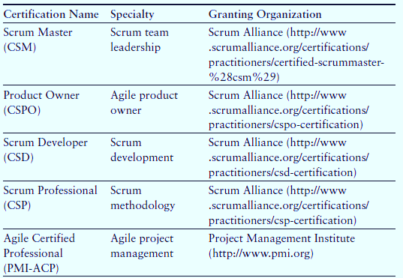
Certifications

Slide 43
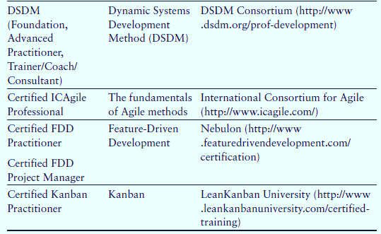
Certifications

